Slide 1
Domina la Graph API, domina el mundo
Luis Mañez (MVP)
Notes:
This slide is mandatory. Please do not remove.

Slide 2
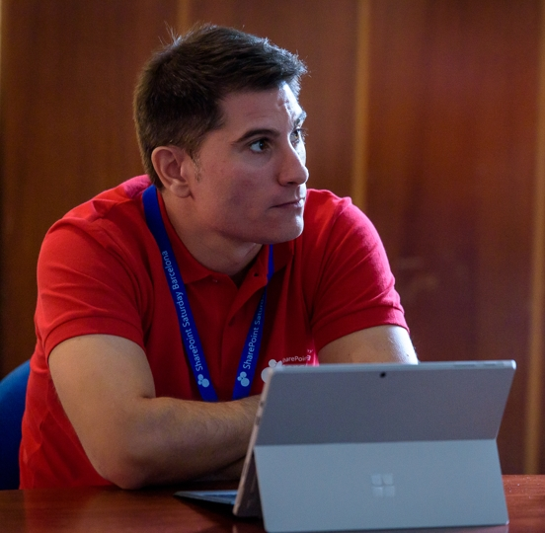
Luis Mañez
Cloud architect
ClearPeople LTD (U.K)
https://medium.com/inherits-cloud
@luismanez
Office Development MVP. About 15 years of experience working with Microsoft Technologies. MS Certified specialist in Developing Azure and SharePoint MCPD. Passionate about technology, blogger, technical writer and MS community active member.

Slide 3
Notes:
This slide is mandatory. Please do not remove and try to use it during Q&A at the end of your session. Thank you!

Slide 4
WiFi Keys for Attendees
Connect to the wireless network MSFT_GUEST
Login details for the wireless network:
Guest Username O365Sat@outlook.com
Guest Password: 0195

Slide 5
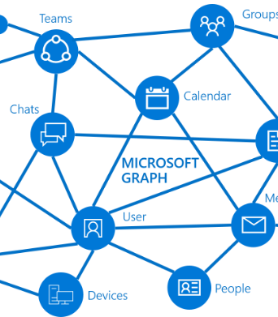
Que es MS Graph?

Slide 6
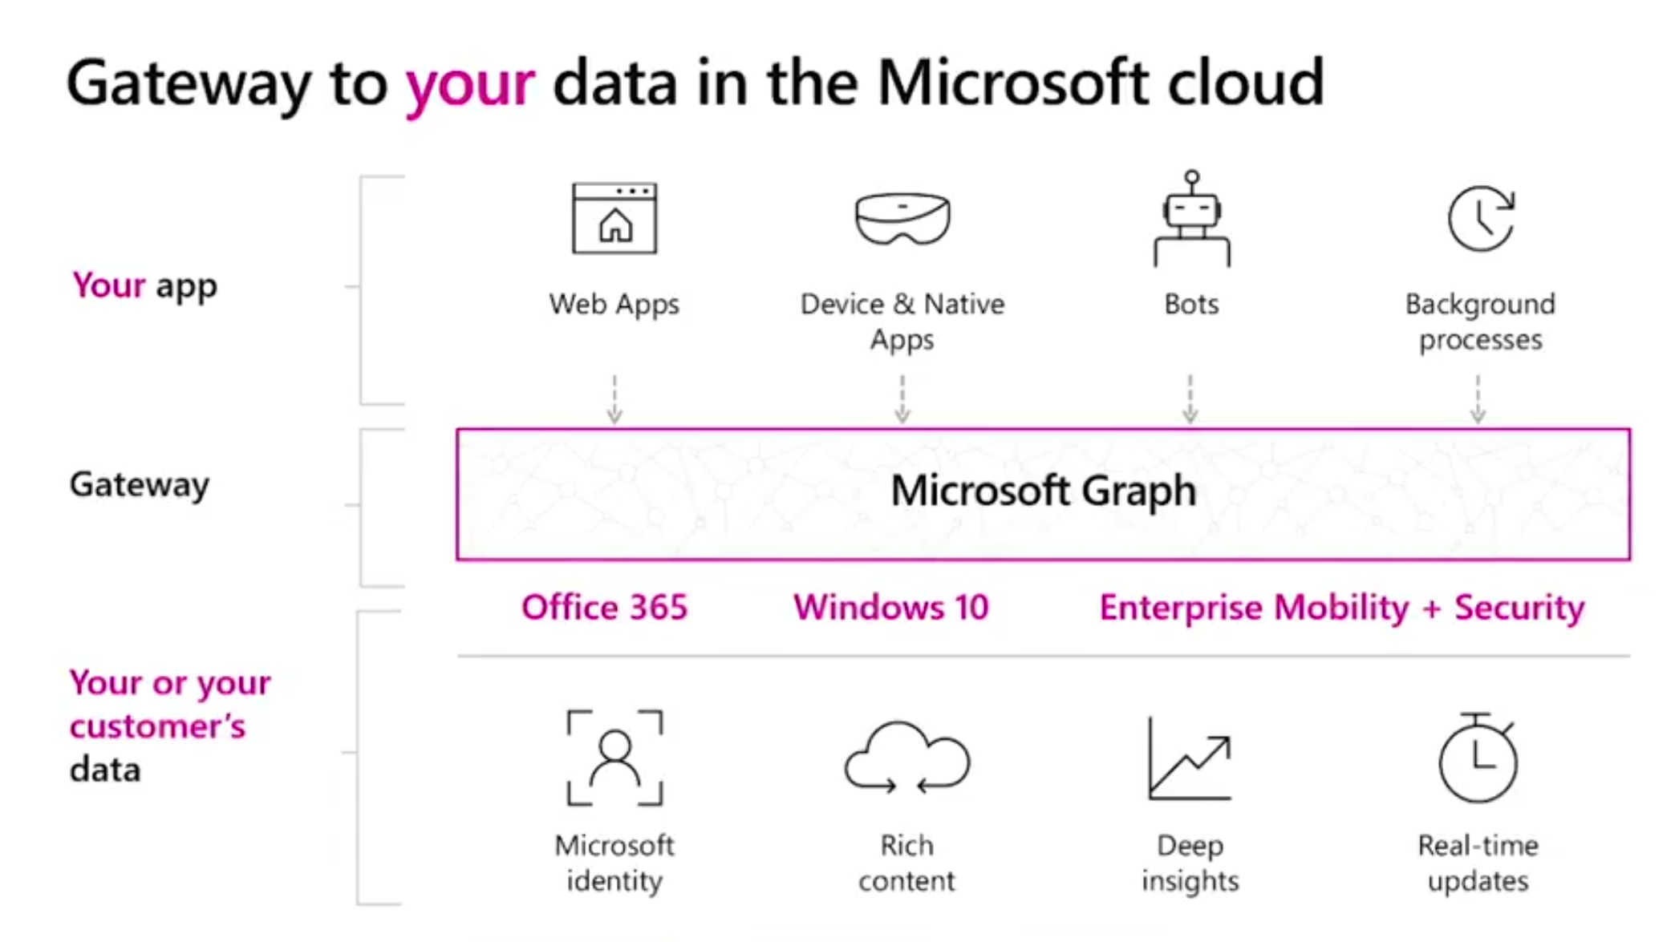

Slide 7
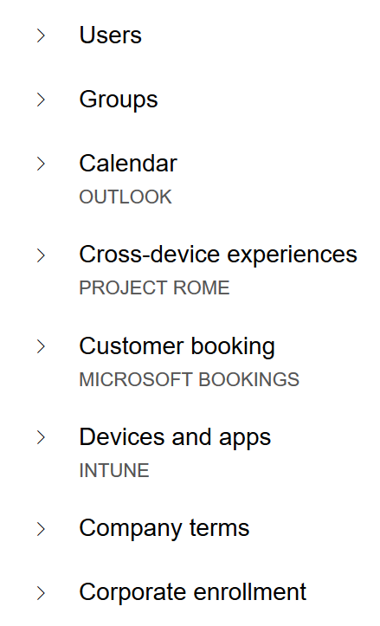
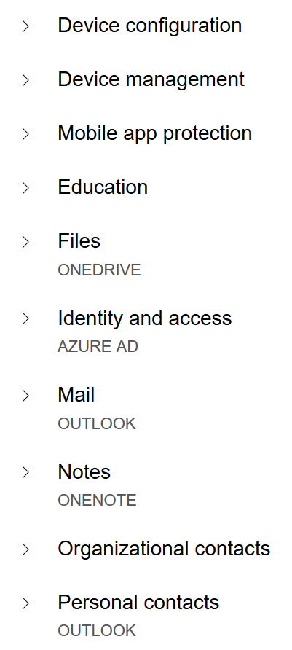
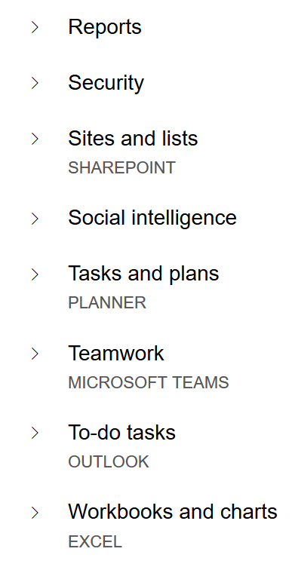
MS Graph Endpoints

Slide 8
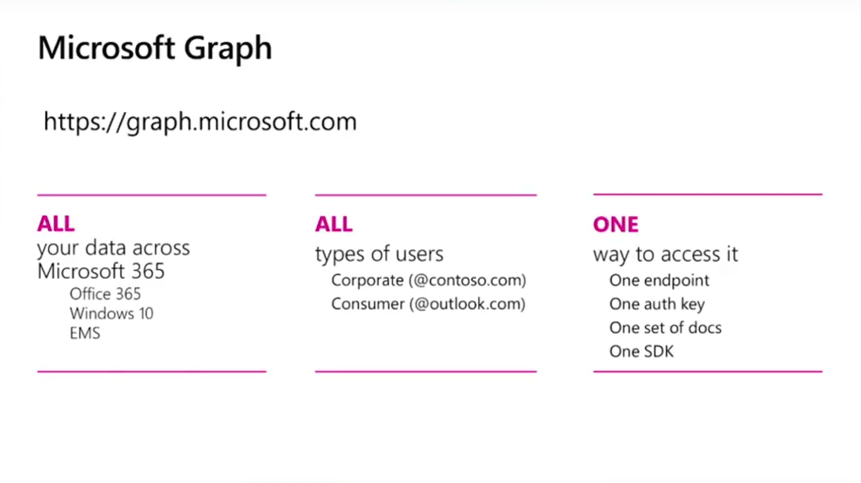

Slide 9

Azure AD Authentication

Slide 10
Azure AD Conceptos
Azure AD Auth esta basado en oAuth 2.0 y OpenIdConnect
MS Graph require un Access Token de Azure AD para ser consumida
Registrar App en Azure AD
Azure V1 vs v2 Endpoint
Asignar permisos
Consent Framework

Slide 11
Azure AD v1 vs v2 endpoints
V1 endpoint
V2 endpoint
Portal | portal.azure.com | apps.dev.microsoft.com
Accounts supported | Work / School | Work / School / Personal
Set of APIs | ALL (Graph, SharePoint, Intune, Skype…) | Only Graph API
Multiple Platforms in App | No | Yes
Scopes | Resource | Request
Consents | Static | Dynamic
Multi-Tenant | Requires configuration | By default
Nuget Package | Microsoft.IdentityModel.Clients.ActiveDirectory | Microsoft.Identity.Client
https://docs.microsoft.com/en-us/azure/active-directory/develop/active-directory-v2-limitations
https://docs.microsoft.com/en-us/azure/active-directory/develop/active-directory-v2-compare

Slide 12










Escenarios de consumo

Slide 13
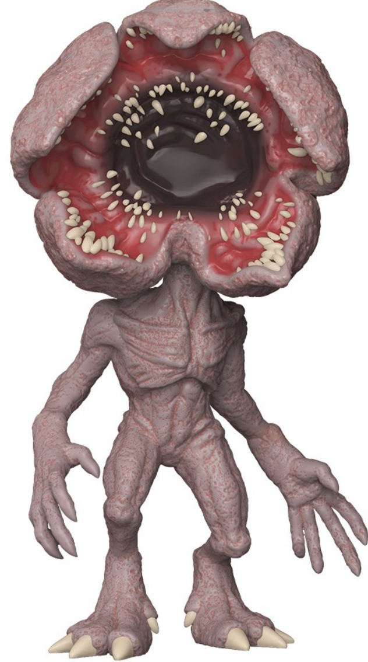

Demo…
…gorgon

Slide 14

Tips & Tricks

Slide 15

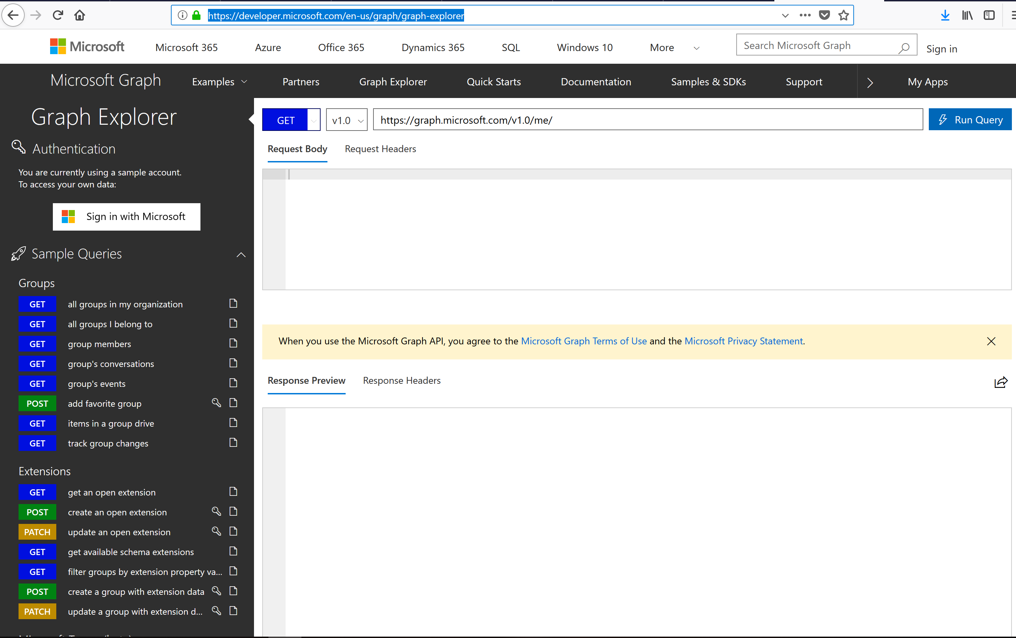
Graph explorer es tu “BFF”
1

Slide 16
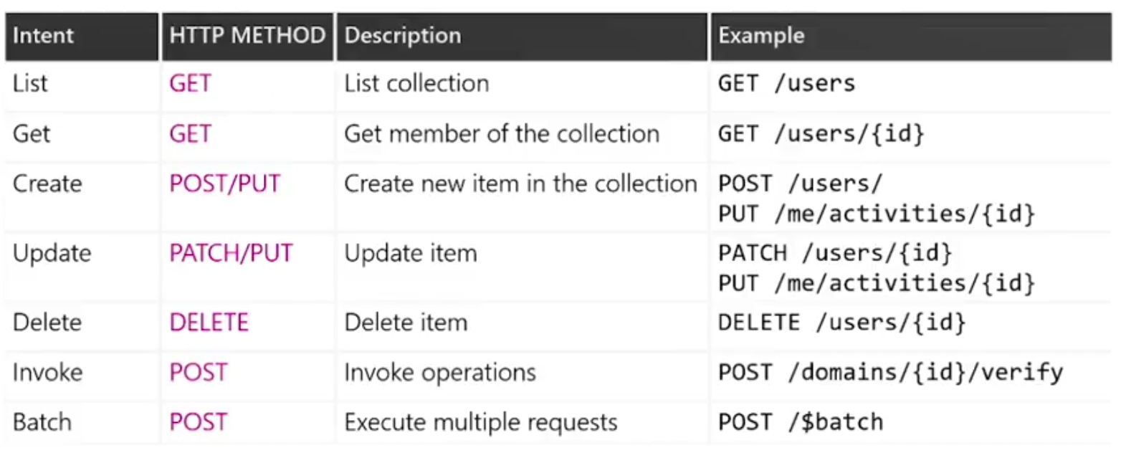
Los 7 magnificos (operaciones)
2

Slide 17
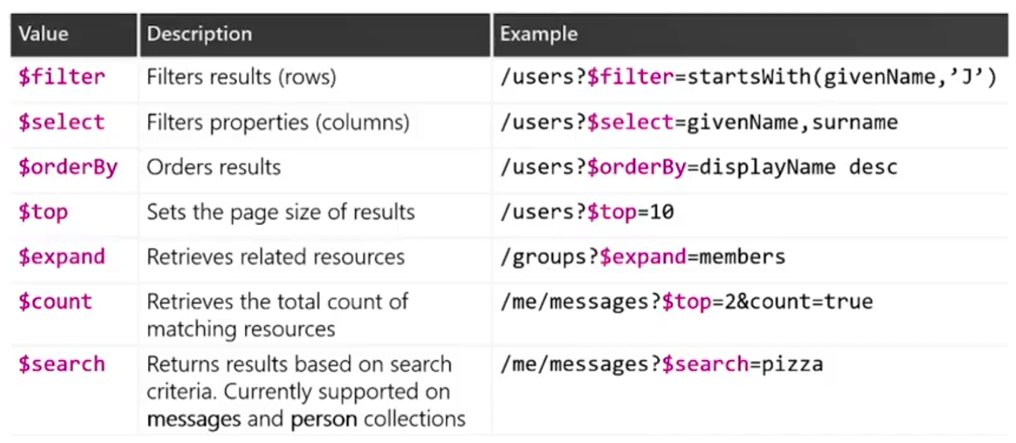
Los 7 magnificos (query parameters)
3

Slide 18
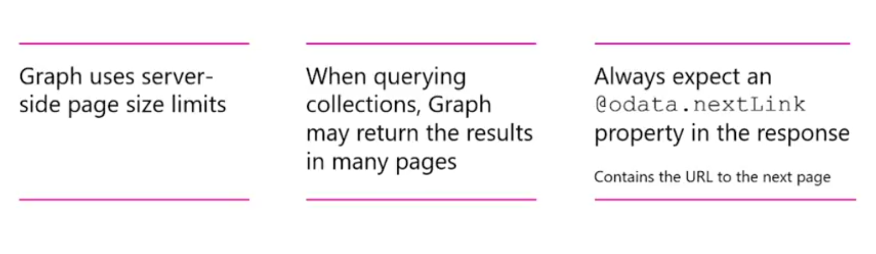
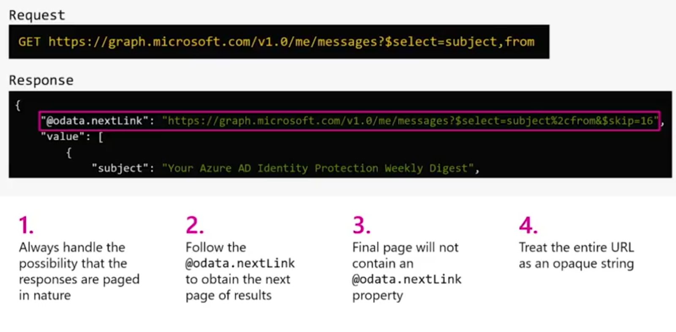
Server-side pagination
4

Slide 19
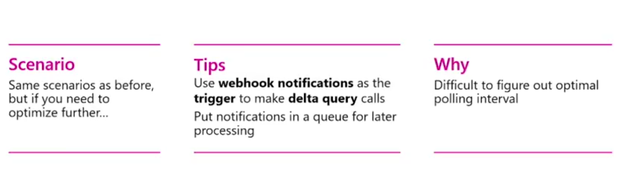
Track changes: webhooks + delta queries
5

Slide 20
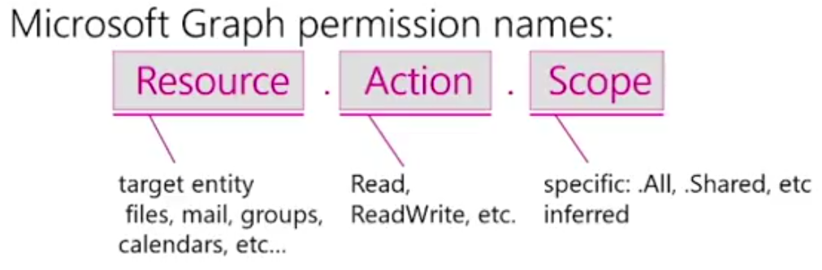
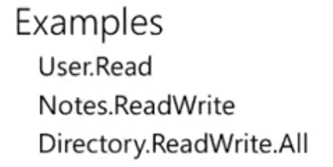
Use least privileges
6

Slide 21
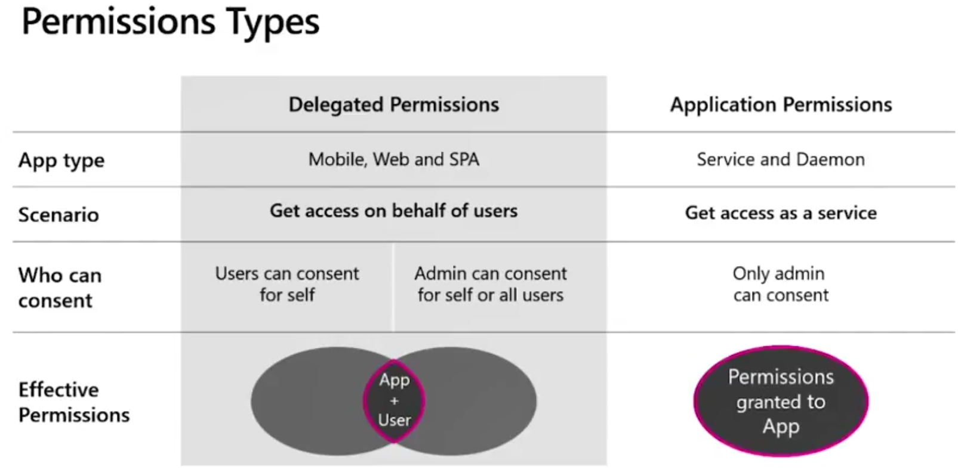
Use least privileges
6

Slide 22

MS Graph Extensions

Slide 23
MS Graph extensions
Permite almacenar nuestros propios datos en MS Graph.
Ejemplo: ampliar los datos de un usuario con “su color favorito”
Open extensions
Estructura flexible
Key-Value list
Schema extensions
Datos “tipados”
Validacion de tipos

Slide 24
Demo…
…gorgon

Slide 25

Batch Requests

Slide 26
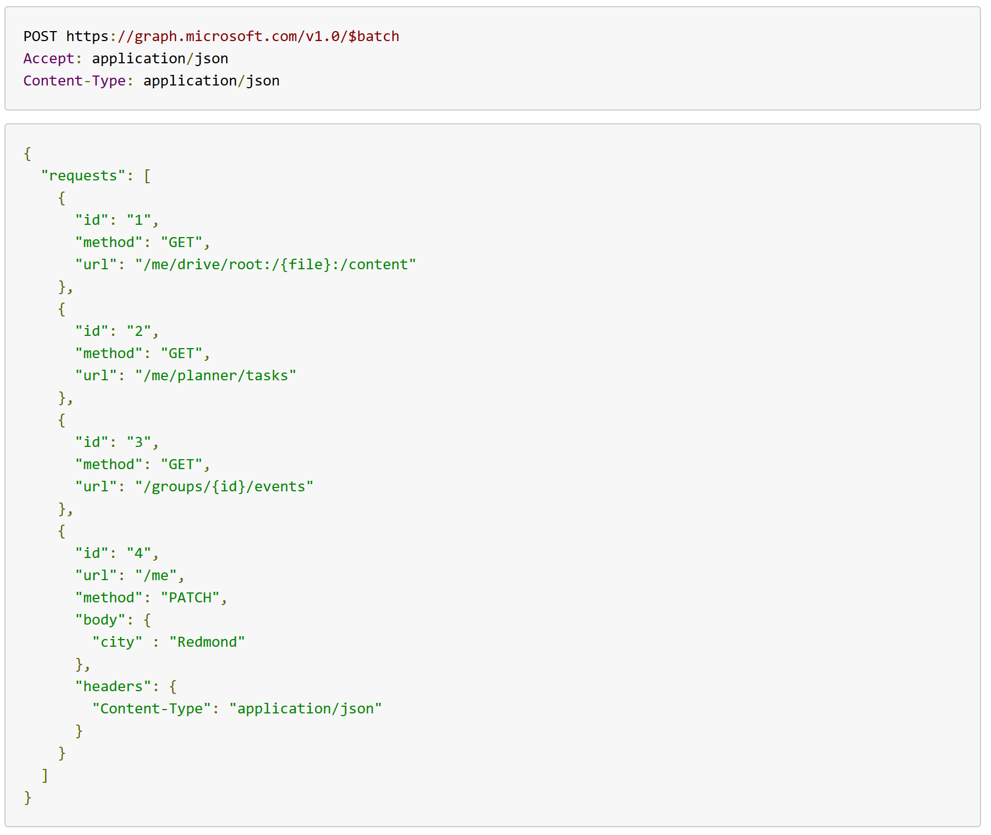
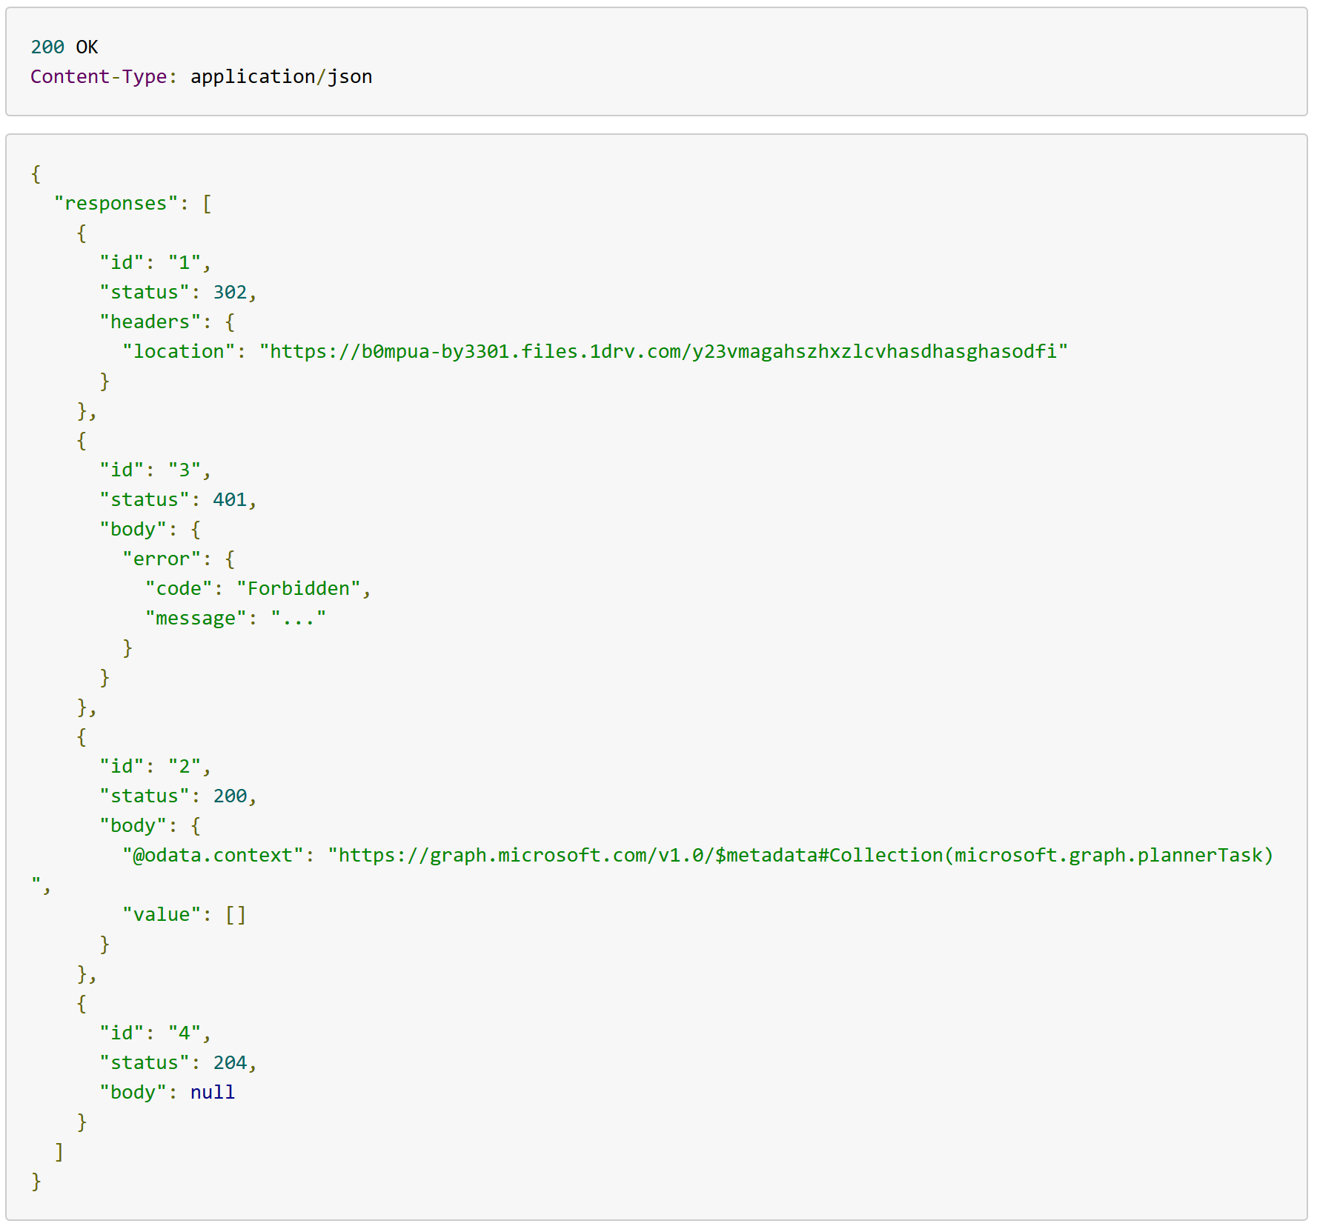
Batch Request / Response

Slide 27
Limitaciones Batch requests
No se pueden anidar peticiones Batch
No es transaccional
URIs deben ser relativas
Máximo 20 peticiones en Batch
Dependencias simples “dependsOn”

Slide 28
Demo…
…gorgon

Slide 29
Resources
MS Graph main page:
https://developer.microsoft.com/en-us/graph
MS Graph explorer:
https://developer.microsoft.com/en-us/graph/graph-explorer
Azure AD MS Graph samples
https://github.com/Azure-Samples?utf8=%E2%9C%93&q=graph&type=&language=
Build 2018 MS Graph Videos:
https://channel9.msdn.com/Events/Build/2018?sort=status&direction=desc&tag%5B0%5D=microsoft%2Bgraph&page=3

Slide 30
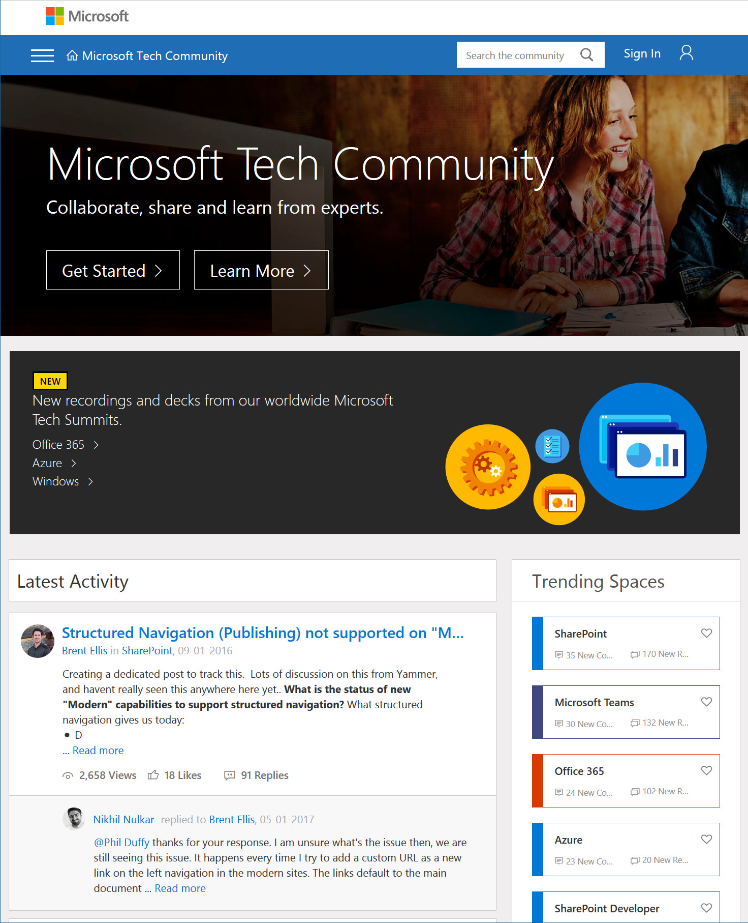
Microsoft Tech Community
techcommunity.microsoft.com
One Microsoft community for IT Pros and tech enthusiasts to learn from experts on Microsoft products
Trusted resource for news, best practices and answers from Microsoft product teams and MVPs
Join today! It’s free – sign in with your Microsoft Account.

Slide 31
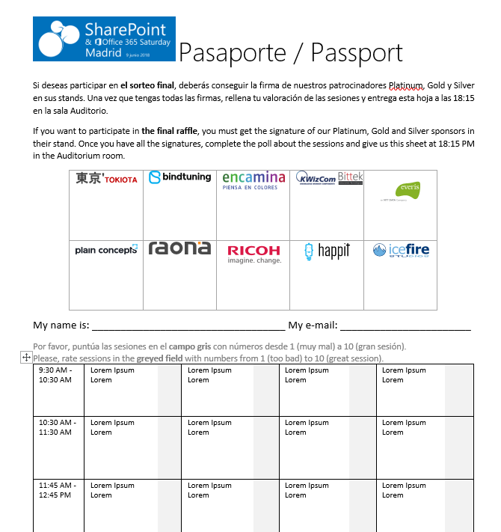

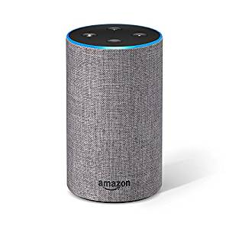
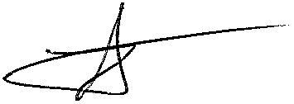




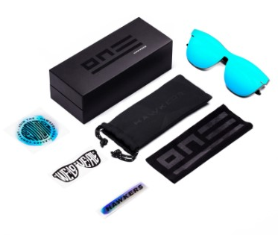


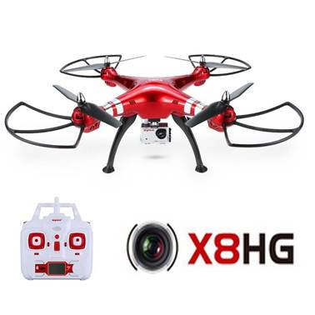




Raffle
Please, fill your SP & Office 365 Saturday Madrid passport if you want to participate.
You can win one of these gifts:
Please, fill your SP & Office 365 Saturday Madrid passport if you want to participate.
You can win one of these gifts:
Odor
Odor@winterfell.com
10
9
2x
2x
8

Slide 32
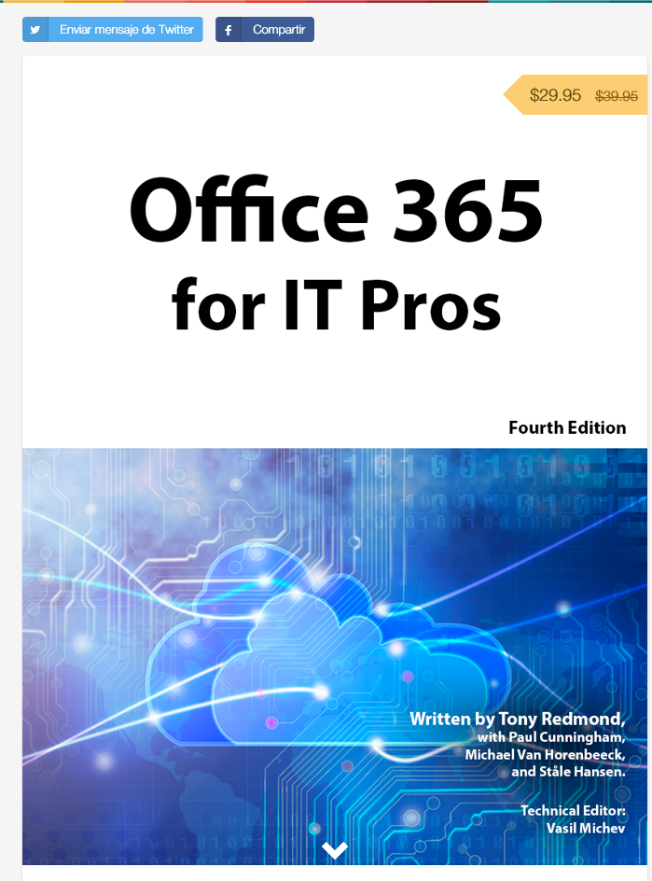
Office 365 for IT Pros
Get a discount of $10 buying the book here: https://gumroad.com/l/O365IT/spsspain

Slide 33
Notes:
This slide is mandatory. Please do not remove and try to use it during Q&A at the end of your session. Thank you!

Slide 34
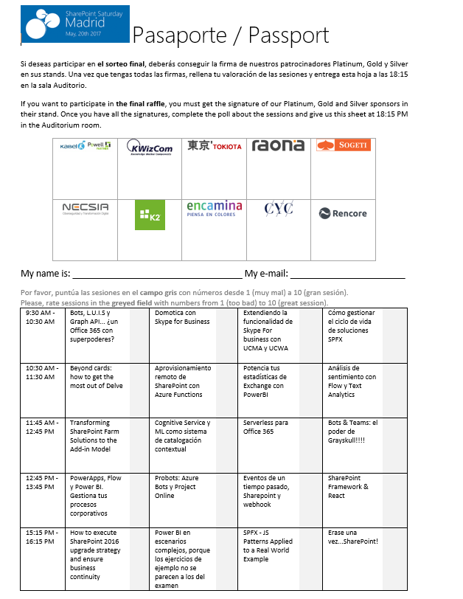
Raffle
Please, fill your SP & Office 365 Saturday Madrid passport if you want to participate.
You can win one of these gifts:
Odor
Odor@winterfell.com
10
9
8

